Slide 1
MOVIE RECOMMENDATION SYSTEM
By Aryan Sinha (RA2011003010066)
Shruthi Kannan(RA2011003010037)
Gajulapalli Naga Vyshnavi (RA2011003010049)

Slide 2
INTRODUCTION
This project aims to implement a movie recommendation system using collaborative filtering in python and perform exploratory data analysis on the datasets used.
In order to gain valuable insights to make recommendations for users based on ratings of other users who have watched movies with similar ratings to recommend further movies to watch data frames, collaborative filtering techniques will be applied.
This will be done by working and pre-processing a dataset of user-movie ratings which will be stored in a data frame.
The data frame is useful in order to manipulate, filter, sort the data by user movie id or ratings which will then be visualized by visualization libraries like seaborn in order to provide useful insights into the similarities and outliers in the data.

Slide 3
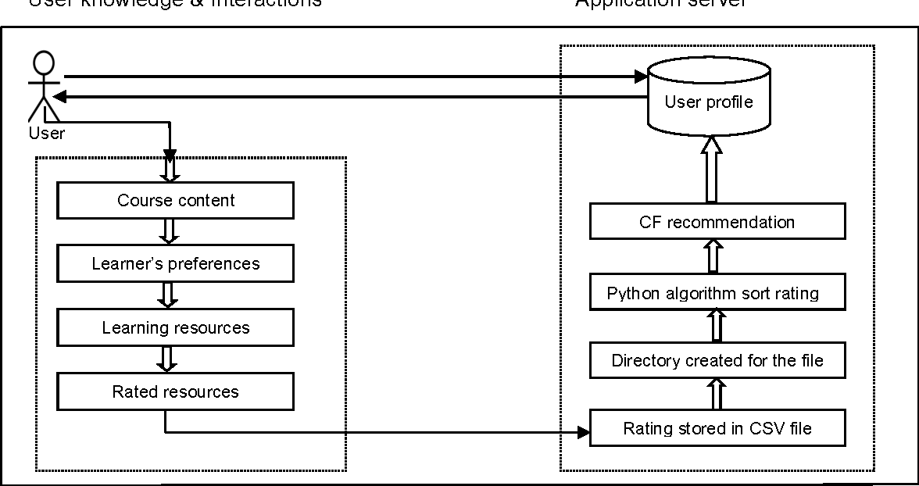

Slide 4
COLLABORATIVE FILTERING
Collaborative filtering is a method of building recommendation systems that relies on user behavior data, such as ratings or purchases, to identify patterns of similarity between users and items.
The idea behind collaborative filtering is that users who have similar preferences in the past are likely to have similar preferences in the future.
There are two main types of collaborative filtering:
user-based
item-based.

Slide 5
In user-based collaborative filtering, similarities between users are calculated based on their ratings of items.
For example, if two users have rated many movies similarly, they are considered to be similar users.
In item-based collaborative filtering, similarities between items are calculated based on the ratings given to them by users.
For example, if two movies are frequently rated highly by the same users, they are considered to be similar movies.

Slide 6
Exploratory Data Analysis (EDA) is a crucial step in the movie recommendation system project in Python. EDA is a process of analysing and visualizing the data to understand its characteristics and extract meaningful insights from it.
In a movie recommendation system project, EDA involves analysing and understanding the dataset, which contains information about the users, movies, and their ratings.
EDA can help to identify patterns, trends, and relationships within the data that can be used to improve the recommendation system's accuracy and effectiveness.
Some common techniques used in EDA for movie recommendation systems include data visualization techniques such as histograms, scatter plots, and heatmaps. These visualizations can help to identify outliers, correlations, and other patterns in the data that may not be immediately apparent through summary statistics alone.

Slide 7
CODES AND OUTPUTS

Slide 8
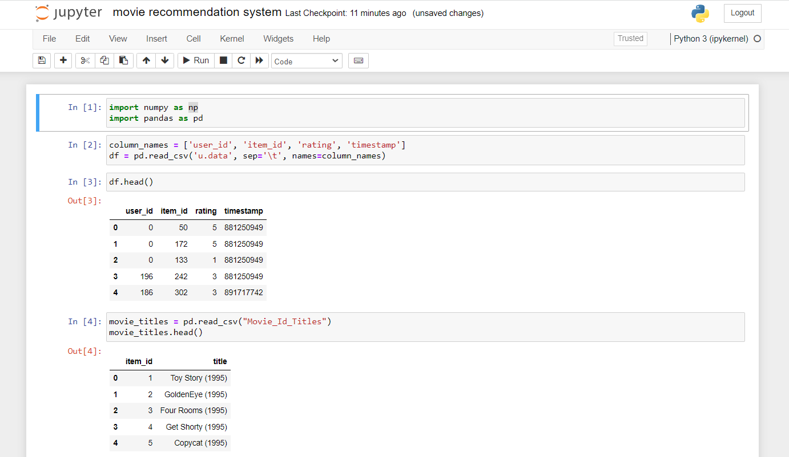
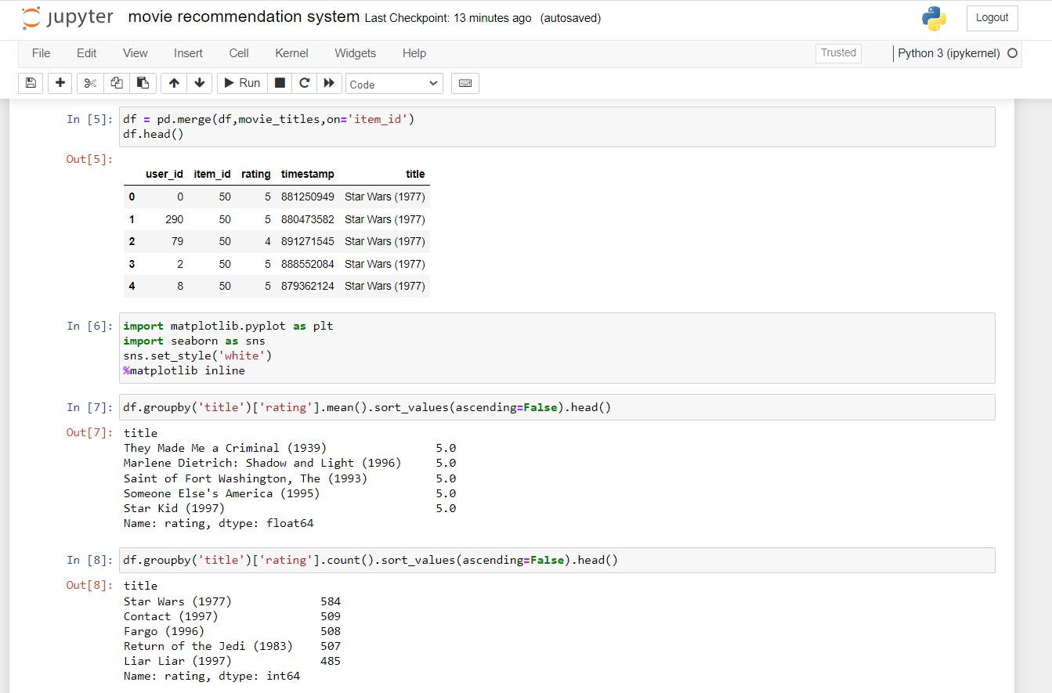

Slide 9
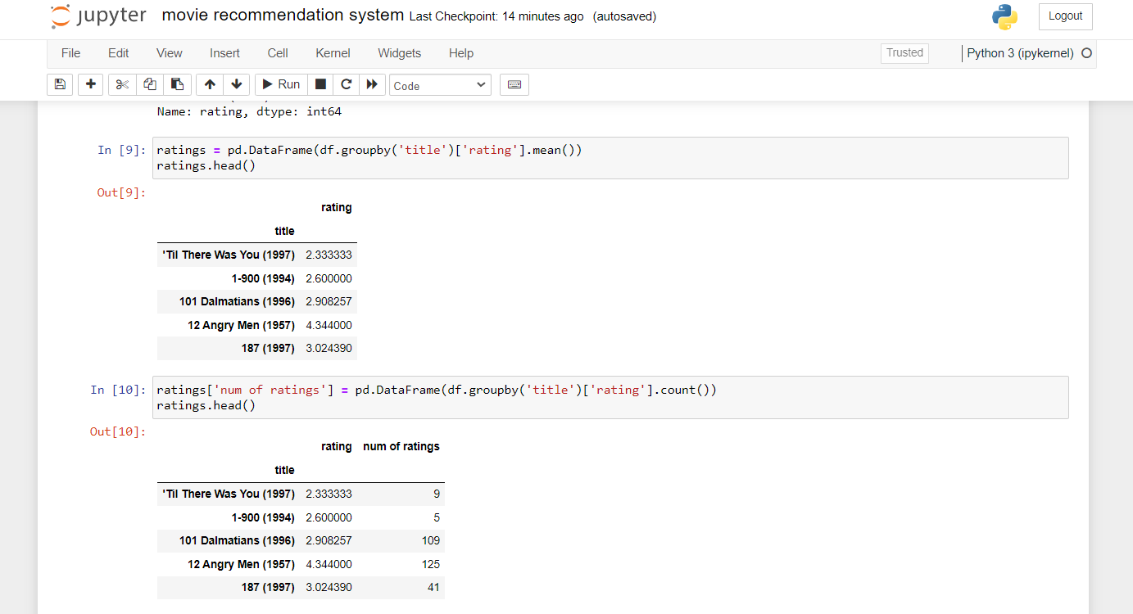
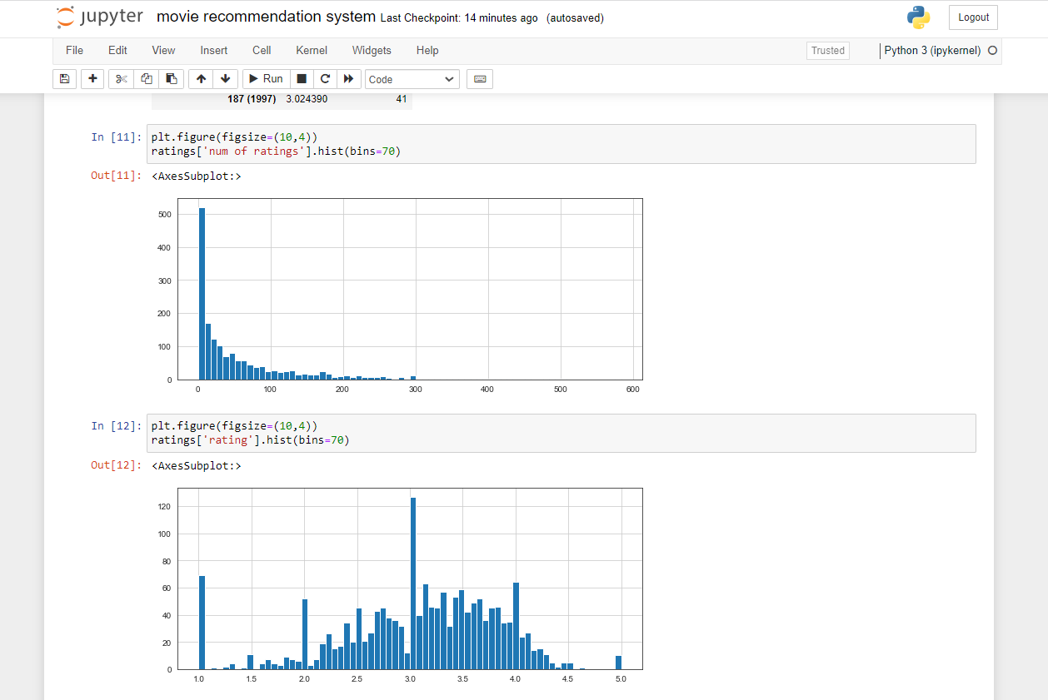

Slide 10
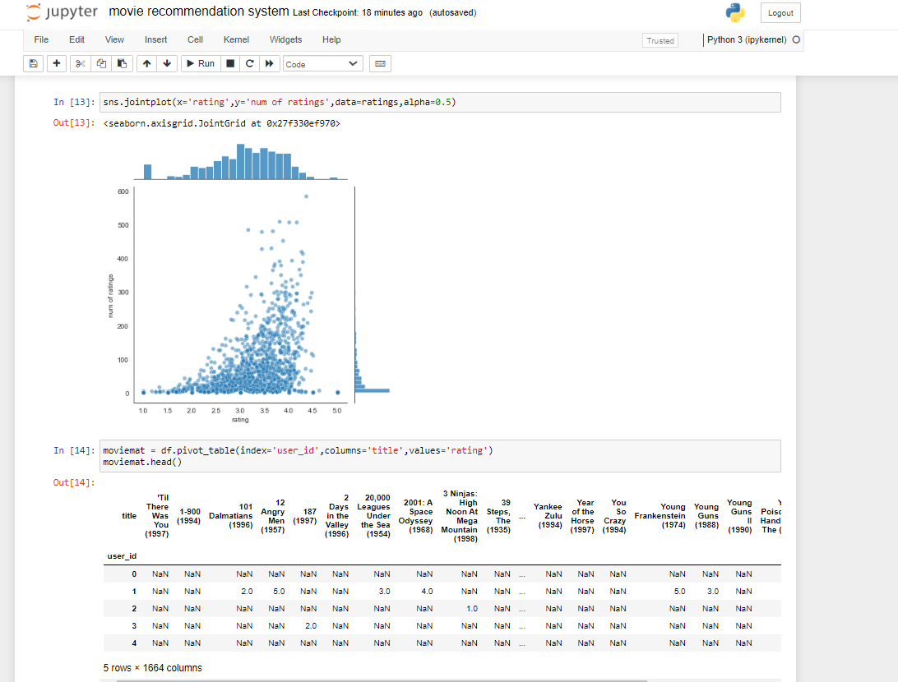
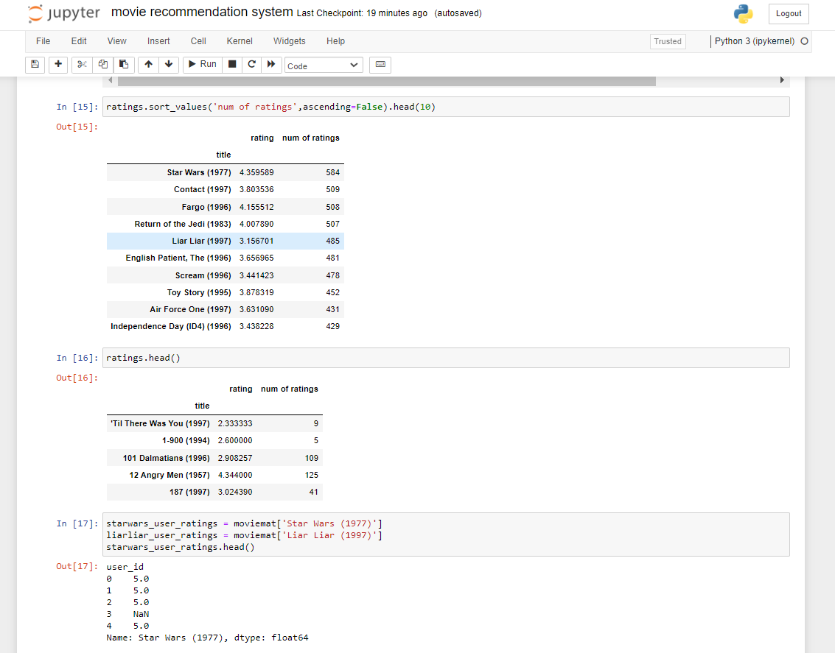

Slide 11
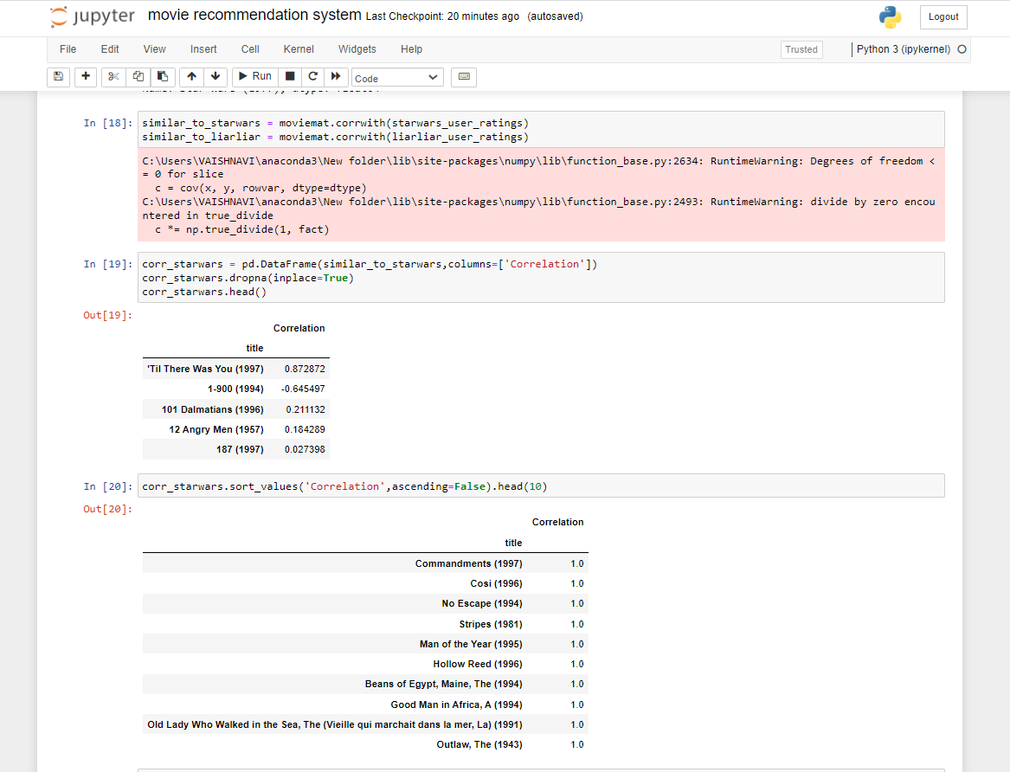
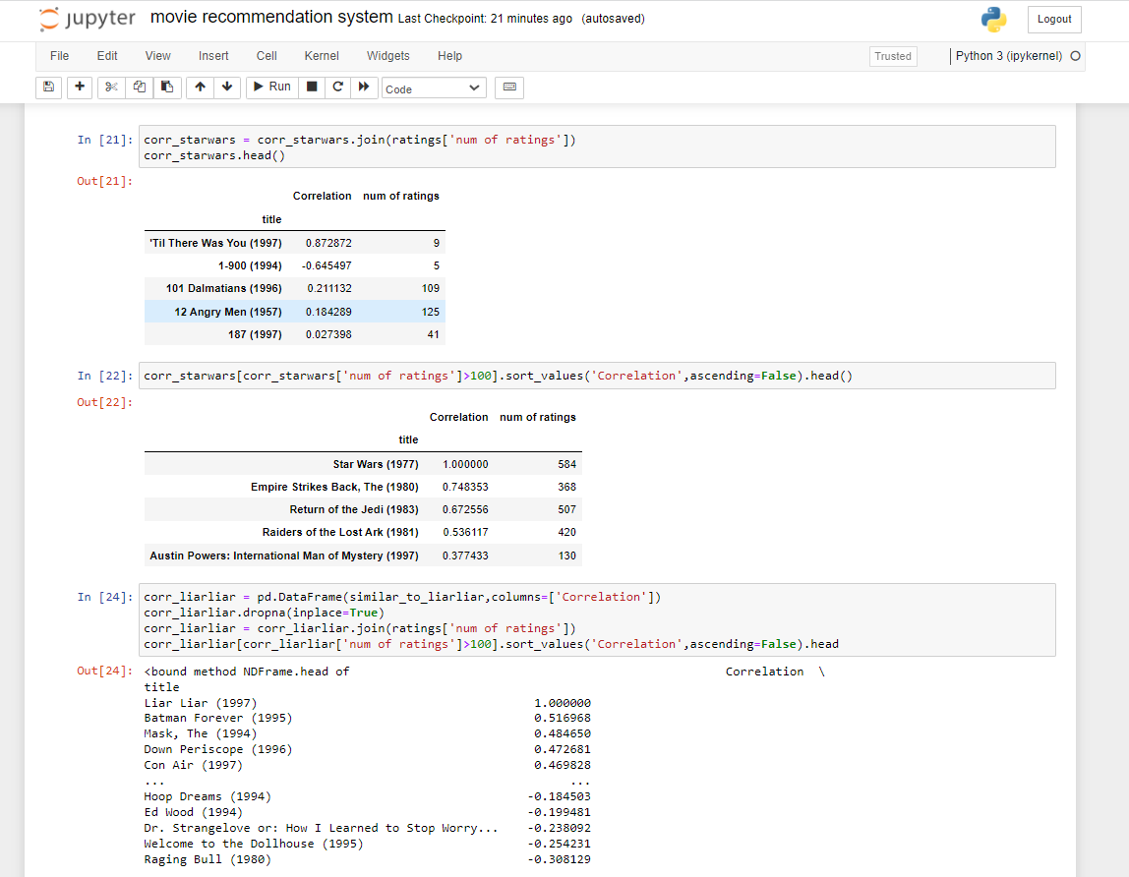

Slide 12
CONCLUSION
This project will demonstrate the implementation of a movie recommendation system with the help of data frames, collaborative filtering and how they can be used to manipulate and analyze large datasets, and build powerful recommendation models.
This project will demonstrate the importance of exploratory data analysis in understanding and visualizing data, and how histograms and Seaborn visualization library can be used to gain insights into the dataset.
Along with building a recommendation system this project also aims to gain insights and understand the patterns and trends in the data using exploratory data analysis. The insights gained from the analysis can be used to make data-driven decisions and guide further analysis.
Correlation using pearson correlation coefficient is used in order to identify similar movies based on user ratings, which can lead to more accurate and personalized recommendations for users.

Slide 13
Thank you

